Slide 1
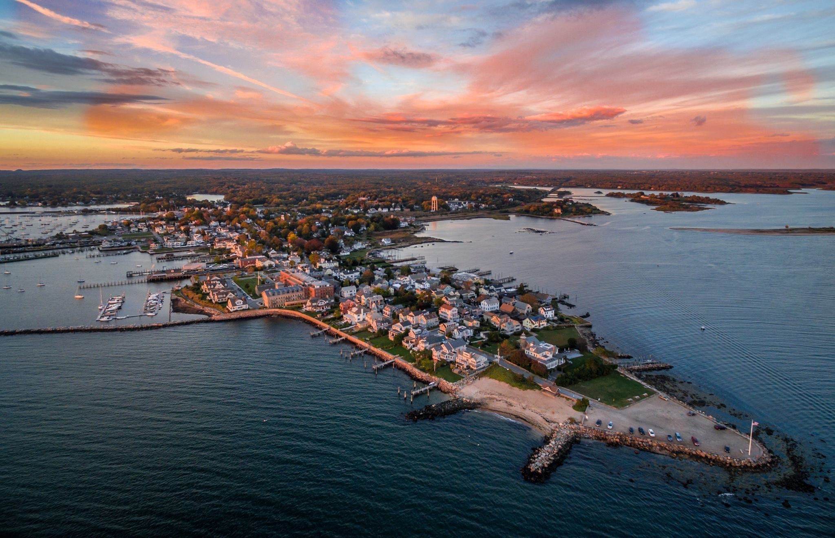
Recommendations for Public bathrooms in Stonington Borough

Slide 2
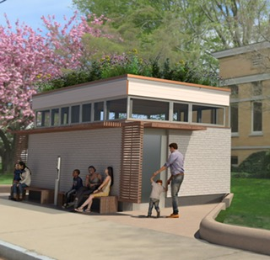
Background
A survey of merchants and non-profits was done in July 2023 and suggests a daily need in summer. This does not include any estimates for parades or events like the Lobster trap Tree which draws hundreds of visitors every day.
A two-year analysis - and two previous Taskforce committees - had identified and designed a two-bathroom option for Wad Square at a cost of $400K, of which over a $140K of funding had been raised.
However, during a community meeting held in August 2023, there were concerns raised about the location and a 3rd Taskforce was created to do another analysis of possible locations.

Slide 3
Comfort station Task force Objective
The objective of the task force - find permanent public bathroom solutions(s) for Stonington Borough that are acceptable to its residents
Opportunity/Focus/Criteria for Comfort Station:
Optimal solution- In an ideal world unisex restroom(s) could include a toilet or two, sink, baby-changing station, urinal, bottle filling station and or drinking fountain and a dog bowl filler
Selection Criteria each location focused on the needs of the Residents/Merchants and Visitors including easy, central convenient location, handicap accessibility, cost-effectiveness, infrastructure (water, sewer, electricity) attractive, safety, impact on neighbors, flood plain, community support.
Locations to be considered - throughout the Borough
Cadence of meetings – Thursday evenings 7-8pm Borough Hall, 26 Church St.
Members – Amanda Barnes, Burgess, Kevin Bowdler, Burgess, Jesse Diggs, Annette Bienkowski(ex-officio), Sarael Sargent, Ellen Wightman, Al Razzano, Julia Leeming (ex-officio), Janet McClendon, Allegra Griffiths, Karen Von Ruffer Hills, Tim Olson, Chuck Hartmann, Jean Fiore, Michael Schefers,(ex-officio)

Slide 4
Comfort Station Timeline/Evolution/Activities/Scope of work
9/21
9/28
10/5
10/11
10/26
11/2
11/9
11.15
Kickoff/Objective /Possible locations/Analysis of locations
Analysis Readouts/Location Refinement
Rubric scoring for locations to be completed by each member/location refinement
Create single rubric scoring for committee/refinement of locations
Reduce shortlist to 2-3 locations/invite Andrew re:Bodega location/View Boro Hall option/Port o Loo upgrades
Review draft presentation and recommendations by committee and make changes as appropriate
Discuss Bodega option with owner Andrew/Discuss upgrade options for playground/dog park and point port o loo/Discuss process to estimate costs for shortlist options
Reviewed cost spreadsheet options and refined recommendations to 4 options and putting recommendation package together for proposal to Warden/Burgesses

Slide 5
9/21
Locations for Analysis
Stonington Free Library
Stonington Borough Sewer Treatment Plant
Borough Bodega
Merrill House
Playground
Borough Hall
Fire House
La Grua Center
St. Mary’s Church
High end Porta Loos
Wimpheimer Park
United Church
Matthews Park
Dodge Paddock
NESS
PHGS
Wadawanuck Square
Stonington Point
Wayland’s Wharf
Calvary Church
Stonington Lighthouse
Open Space between St. Mary’s Church and Post office
La Grua Park
Docks
East Lawn at the Point
25 Locations analyzed

Slide 6
Comfort Station Location Analysis
Location: Team Members Date
Brief Description of the project
Review xxxx site as a potential candidate for Public Bathrooms
Advantages (at least Three)
Disadvantages (at least Three)
Would you recommend that this project be recommended for further analysis? YES/NO
Example of the Comfort Station Location Analysis Document

Slide 7
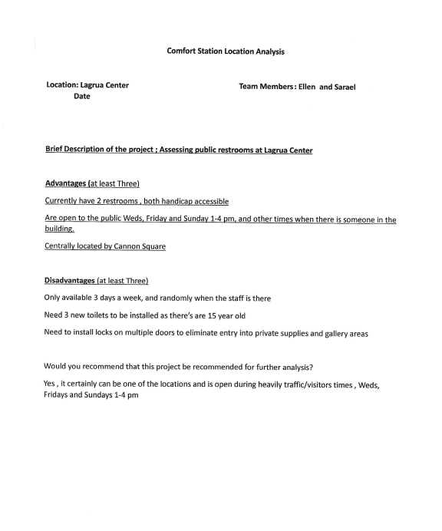
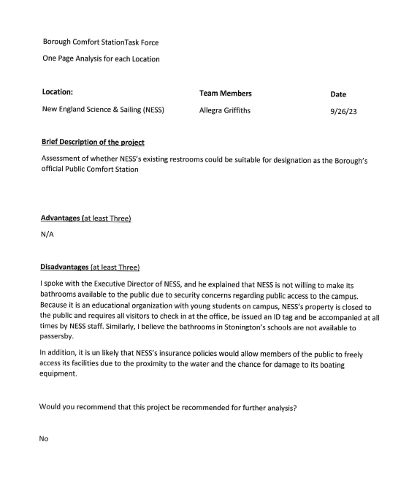
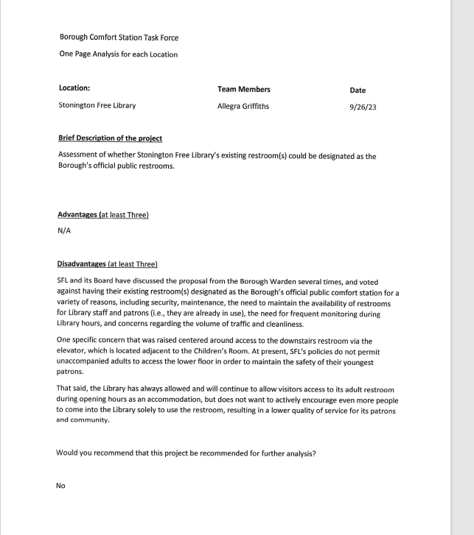
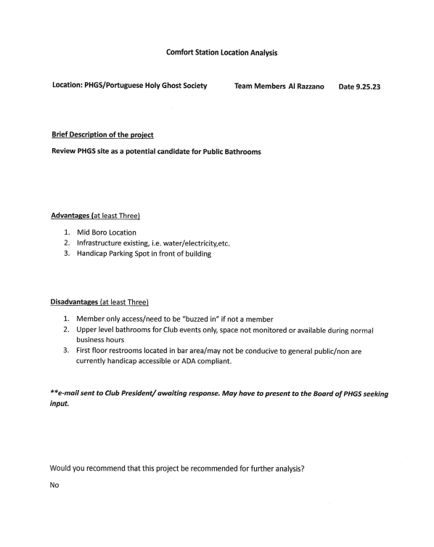
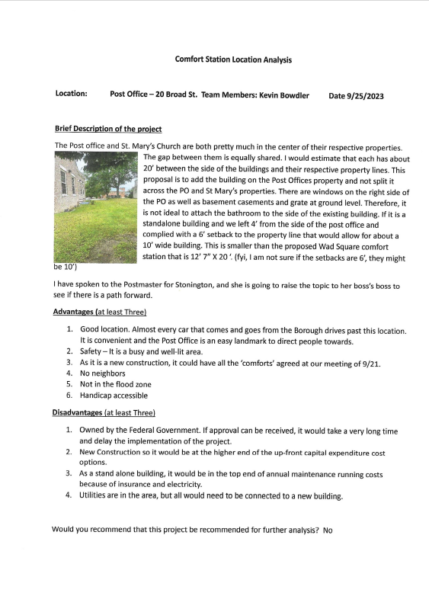
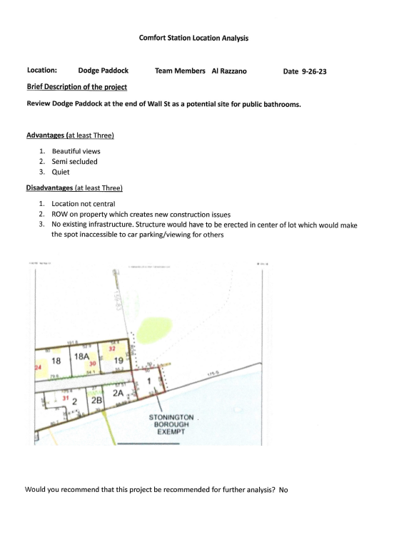
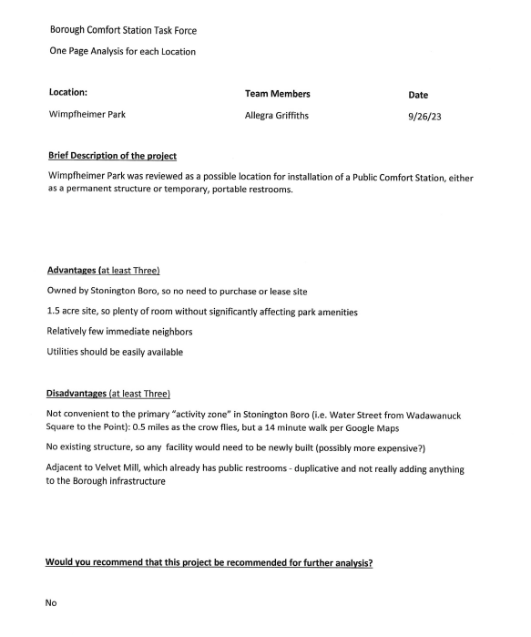
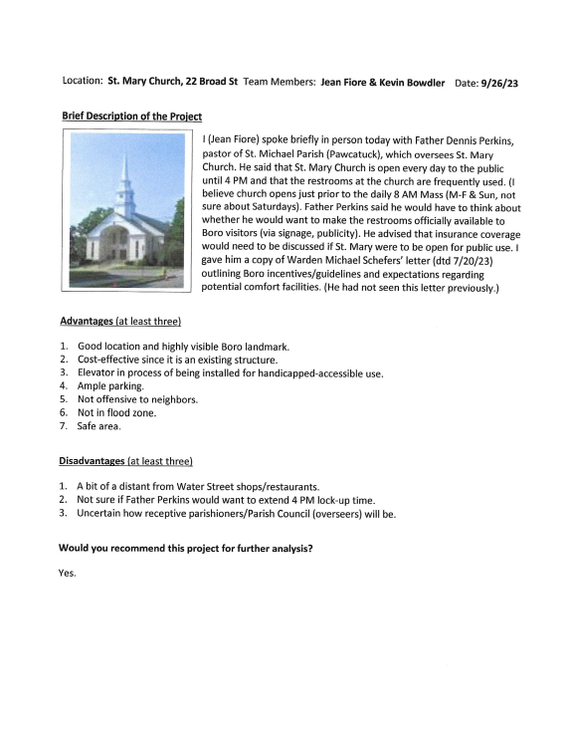
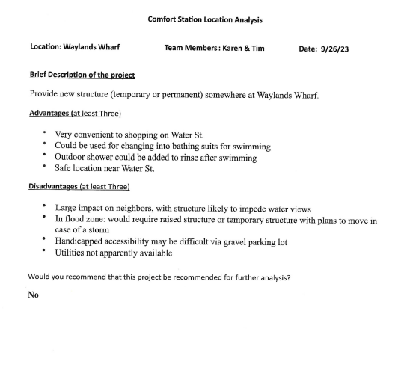
9/28
Analysis – Location review and refinement. Agreed which locations do not make sense and removed them from the list. We also removed properties whose owners were not amenable to hosting public bathrooms. E.g. James Merrill House, Mathews Park, Library etc.

Slide 8
10/5
Agreed Rubric Design
Reduced locations from 25 to 7 + 4 TBD. Agreed upon criteria for rubric. The criteria is how the weightings 1,2,3 calculated the total points for each location. Each member to complete their own rubric for 10-11 meeting.
Example Criteria Evaluation
1 | 2 | 3
New Build/Infrast | Renovate Existing | No Renov Needed / Portable
Standalone Facility | Part of Existing Building | Vendor Liability / Portable
Unmanned Facility | Part Time Oversight | In Supervised Site
Remote/Vacant Facility | Busy Location/Stand Alone | InTown/Busy Facility
Distant | Walkable | Inside Comm District
Challenging | Doable | Exists Today / Portable Potts
Eyesore to Majority | Impacts 3-7 Homes | 1-2 Homes / Exist Facility
Much land around | Little Land around | Secured Area
Narrow Road/Little Parking | Average for Borough | Widest Road/Ample Parking
8+ Homes Adjacent | 3-5 Homes Adjacent | 1-2 Homes or Comm zone
High | Medium | Low
VE (New Build or Renov Only) | AE (New Build or Renov Only) | Portable Potts, Existing Building or no Flood Zone
Cost and Ease of Construction
Annual Operating Cost
Personal Security
Site Safety: Vandalism, Drug Use, Vagrancy
Easily Found / Close to Commercial District
Handicap Accessible
Attractive
Surrounding grounds able to be camped upon
Car Traffic & Parking Availability
# of Residences within 100 feet
Zoning change of use
Flood Zone

Slide 9
10/11
Consolidated Rubric
Rubric scoring for locations to be completed by committee consensus for single spreadsheet and 7 locations
Stonington Borough
Public Facility
Task Force
 |  |  |  | Existing Facilities |  |  |  |  |  | New Facilities
 |  |  |  | Saint
 | Example Criteria Evaluation |  |  | Mary's | Lagrua | Fire | Borough | Boro |  | Play Ground |  | Point Parking |  |  | Dog Park
 | 1 | 2 | 3 | Church | Center | House | Hall | Bodega |  | Portable | Permanent | Portable | Permanent
Cost and Ease of Construction | New Build/Infrast | Renovate Existing | No Renov Needed / Portable | 3 | 3 | 3 | 3 | 2 |  | 3 | 1 | 3 | 1 |  | 3
Annual Operating Cost | Standalone Facility | Part of Existing Building | Vendor Liability / Portable | 3 | 3 | 3 | 3 | 3 |  | 2 | 1 | 2 | 1 |  | 2
Personal Security | Unmanned Facility | Part Time Oversight | In Supervised Site | 2 | 3 | 3 | 3 | 3 |  | 2 | 2 | 3 | 3 |  | 2
Site Safety: Vandalism, Drug Use, Vagrancy | Remote/Vacant Facility | Busy Location/Stand Alone | InTown/Busy Facility | 2 | 3 | 2 | 2 | 3 |  | 2 | 2 | 1 | 1 |  | 2
Easily Found / Close to Commercial District | Distant | Walkable | Inside Comm District | 2 | 1 | 1 | 3 | 3 |  | 3 | 3 | 1 | 1 |  | 2.5
Handicap Accessible | Challenging | Doable | Exists Today / Portable Potts | 3 | 3 | 3 | 3 | 2 |  | 3 | 1 | 3 | 1 |  | 3
Attractive | Eyesore to Majority | Impacts 3-7 Homes | 1-2 Homes / Exist Facility | 3 | 3 | 3 | 3 | 3 |  | 2 | 1 | 2 | 1 |  | 2
Surrounding grounds able to be camped upon | Much land around | Little Land around | Secured Area
Car Traffic & Parking Availability | Narrow Road/Little Parking | Average for Borough | Widest Road/Ample Parking | 3 | 1 | 3 | 2 | 2 |  | 3 | 3 | 3 | 3 |  | 3
# of Residences within 100 feet | 8+ Homes Adjacent | 3-5 Homes Adjacent | 1-2 Homes or Comm zone | 2 | 1 | 2 | 2 | 3 |  | 2 | 2 | 3 | 3 |  | 3
Zoning change of use | High | Medium | Low | 3 | 3 | 3 | 3 | 3 |  | 3 | 1 | 3 | 1 |  | 3
Flood Zone | VE (New Build or Renov Only) | AE (New Build or Renov Only) | Portable Potts, Existing Building or no Flood Zone | 3 | 3 | 2 | 2 | 2 |  | 3 | 2 | 3 | 1 |  | 3
 |  |  |  | ==== | ==== | ==== | ==== | ==== |  | ==== | ==== | ==== | ====
Sum of Points (Less is Bad, Higher is Better) |  |  |  | 29 | 27 | 28 | 29 | 29 |  | 28 | 19 | 27 | 17
9

Slide 10
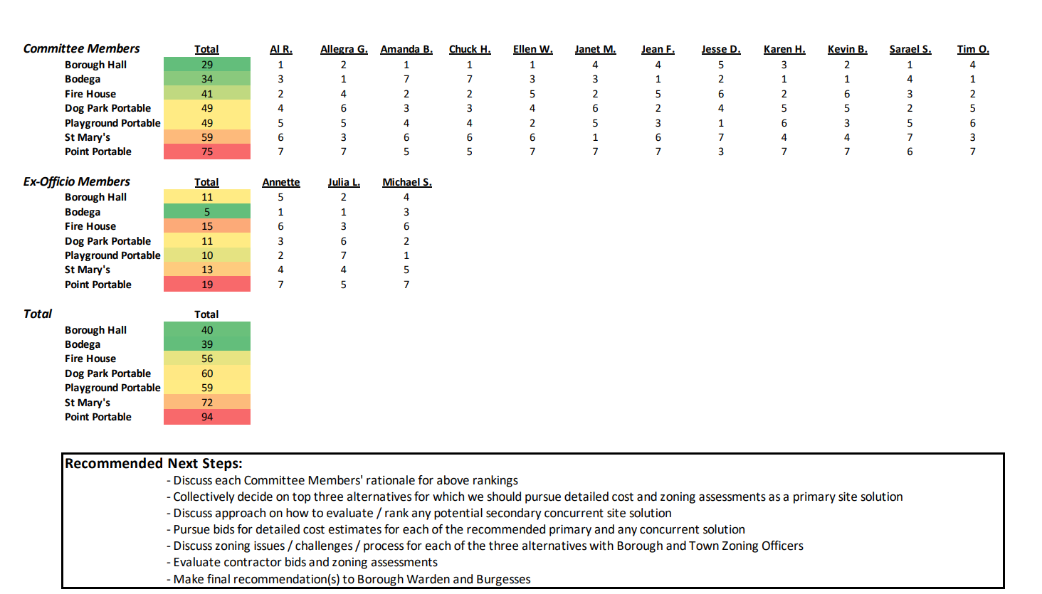
Consolidated Ranking
10/26
Reduce shortlist to 2-3 locations/invite Andrew re:Bodega location/View Boro Hall option/Portaloo upgrades

Slide 11
Discuss Bodega option with owner Andrew/Discuss upgrade options for playground/dog park and point port o loo/Discuss process to estimate costs for shortlist options
11/9
Reviewed the findings of the Borough Hall and Boro Bodega working groups. Also reviewed cost spreadsheet options and refined recommendations to 4 options and putting recommendation package together for proposal to Warden/Burgesses//Initial Estimates of costs
Significant Dialogue on Porto Loo options and Public comment
DRAFT ONLY
Estimated Comfort Station Annual Operating costs | Boro Bodega | Borough Hall. 1 ADA bathroom | Borough Hall 2 Bathrooms | Porta Loo High End - Rent | Porta Loo High End - Buy | Porta Loo Low end Buy | Porta Loo Low-End Rent | Expand Existing Porta Pottie Rent
Description | Amount | Amount | Amount | Amount | Amount | Amount | Amount | Amount
Annual Rent/Lease | $30,000 | $0 | $0 | $48,000 |  |  | $48,000 | $5,760
Insurance | $1,000 | No additional cost | No additional cost |  |  |  |  | na
Electric | $1,400 | $180 | $180 | $2,160 | $2,160 | $2,160 | $2,160 | na
Heating | TBD | No additional cost | No additional cost | part of elect bill | part of elect bill | part of elect bill | part of elect bill | na
Cleaning - twice per day 4 months, once per day 8 months | $14,280 | $14,280 | $14,280 | $14,280 | $14,280 | $14,280 | $14,280 | $2,880
Cleaning Materials & Supplies - Paper towels, toilet paper | $3,250 | $3,250 | $3,250 | $3,250 | $3,250 | $3,250 | $3,250 | na
Repairs and Maintenance | $2,500 | $2,500 | $2,500 | Includes pump out | $2,500 | $2,500 | $3,940 | na
Water/Sewer | $1,568 | $1,568 | $1,568 | $1,568 | $1,568 | $1,568 | $1,568 | na
Total | $53,998 | $21,778 | $21,778 | $69,258 | $23,758 | $23,758 | $73,198 | $8,640
Borough Budget 1.5MM . % of Borough Budget | 4% | 1% | 1% | 5% | 2% | 2% | 5% | 1%
Cost over 10 Years for Capex plus annual operating costs
Annual operating Costs | $ 539,975 | $ 217,775 | $ 217,775 | $ 692,580 | $ 237,580 | $ 237,580 | $ 731,980 | $ 86,400
Capex | $ 149,000 | $ 30,000 | $ 79,000 | $ 6,000 | $ 86,500 | $ 87,000 | $ 6,000 | $ 3,000
TOTAL - OVER 10 YEARS | $ 688,975 | $ 247,775 | $ 296,775 | $ 698,580 | $ 324,080 | $ 324,580 | $ 737,980 | $ 89,400
Notes:
Rent/Lease Boro Bodega $2,500 pm
Insurance. Existing Borough Property insured value of 3.3MM at annual premium of $21,447. Borough Bodega CAPEX est 100K for Insurance rebuild 350K. 100K/3.3MM X 21,447 = $650. Round up to $1,000. (still seems low.KB will talk to Borough Insurance broker for better estimates.
Use existing umbrella General liability Ins.
Electric. (Bodega - new meter)Est $150 per month for 4 months and $100 pm for 8 months. Borough Hall - existing meter. Assume $15 extra per month
Cleaning est $30 per clean. Fyi, Mystic River Park Commission pays their cleaners $27 per visit (including cleaning supplies). Twice per day in summer plus a thrid clean on days with events. Once per day in winter. Library pays $750 per month for once a day cleaning 7 days per week. $9,000 pa
Cleaning materials and paper Supplies: Library spent $856 combined last fiscal year for probably higher usage numbers. Mystic bathrooms paid $4,642 for supplies. 70% of their usage is $3,250. Andrew Field estimates $15 to $20 per day for bathrooom cleaning and paper supplies. That is $6,400 per year, much higher that Mystic River Park that has 1,000's of uses per week in the summer.
Water/Sewer - assume 30% of Mystic bathroom cost of $5,225 pa = 1568
DRAFT ONLY
Esdtimated Comfort Station Capital Expenditure Costs | Boro Bodega | Borough Hall. 1 ADA bathroom | Borough Hall. 2 Bathrooms | Porta Loo High End - Rent | Porta Loo High End - Buy | Porta Loo low end Buy | Porta Loo Low-End Rent | Expand Existing Porta Pottie Rent
Description | Amount | Amount | Amount | Amount | Amount | Amount | Amount | Amount
Remove interior door/wall at Borough Hall and open up stairway so you can see to the elevator and bathroom. Include security camera's , locks on second floor doors. Maybe glass panels in Church St door. Electronic Lock-out on elevator, Lock upstairs doors, and perhaps pushbutton ADA Compliant access to the front borough hall door and bathroom door. Sink may need retrofit to be ADA compliant. |  | $ 30,000 | $ 30,000 |  | $ 46,500 | $ 67,000
Add additional non ADA Bathroom to the left of Borough Hall entry door. 49 Sqaure feet. Using $1,000 psf. |  |  | $ 49,000
Build 2 NON ADA compliant bathrooms at Boro Bodega. 149 sf X $1,000 psf | $ 149,000
Porta-Loo High End: Improve appearance of all Porta-loo options |  |  | $ - | $ 6,000 | $ 40,000 | $ 20,000 | $ 6,000 | $ 3,000
Total | $ 149,000 | $ 30,000 | $ 79,000 | $ 6,000 | $ 86,500 | $ 87,000 | $ 6,000 | $ 3,000
Cost over 10 years, assuming no inflation | $ 149,000 | $ 30,000 | $ 79,000 | $ 6,000 | $ 86,500 | $ 87,000 | $ 6,000 | $ 3,000
Potential use of Town of Stonington aalocated CAPEX 50K | TBD | TBD | TBD | TBD | TBD | TBD | TBD | TBD
Stonington Borough ARPA Funds approved in 2022 for bathrooms | $ 25,000 | $ 25,000 | $ 25,000 | $ 25,000 | $ 25,000 | $ 25,000 | $ 25,000 | $ 25,000
Notes:
Permanent Structures: The very detailed cost estimates for Wad Square worked out at $1,368/sf of which $285 of that was for the civil/infrastructure work associated with the location. Both locations above, have infrastructure in place. Let's assume we use $1,000/sf, for build out of Boro Bodega and Borough Hall. Additional bathroom at Borough Hall is 49 square feet, Borough Bodega space is 144 square feet for 2 NON ADA compliant bathrooms.
Portaloos: The buy option has an upfront cost that is once only in 10 years. Each port-loo option for both buy and rent have 'improve appearance' options. This is also a one time up-front cost.

Slide 12
11/15
Updated Cost Analysis

Slide 13
Recommendations
The taskforce, through a process of elimination has reduced the number of options to two permanent options at Borough Hall.
Borough Hall options:
Use the (existing) ADA compliant bathroom
Use the (existing) ADA compliant bathroom and add an additional bathroom to create two public restrooms.
Additionally, there is an upgraded portaloo option. This is in addition to the bathroom
options at Borough Hall.
Work with the Town of Stonington to add an additional portaloo at the playground in a new location with a fence, landscaping and increased cleaning.

Slide 14
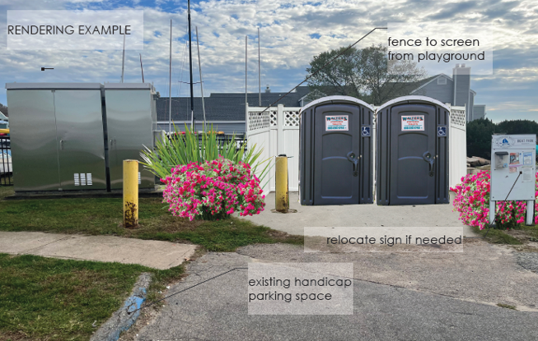
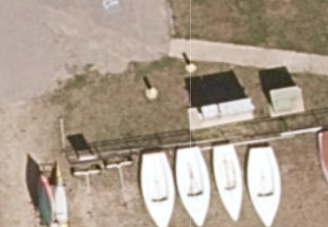
Playground Portaloo Upgrade
Fence to screen from playground
Attractive landscaping
Playground
Existing bollard
Relocate SBA sign if needed
Existing handicap parking
Existing utility boxes
New Porta-Loo Site
2 ADA Units (Mens/Womens); or
1 ADA Unit & 1 Changing Table Unit (Unisex)
Small Boat Assn

Slide 15
Comparison of Locations
Comparison of locations | Borough Hall Option 2 | Wad Square
Cost and Ease of Construction | ~79K for both 1&2 | ~400K
Close to Commercial District | Closer to Coml Zone
Handicap Accessible | Yes | Yes
Comforts e.g. 2 Bathrooms | Yes | Yes
# of Residences within 100 feet | Less
Physical Change to abuilding or a park | No | Yes

